Slide 1

Wind power: Social, environmental and economic concerns
Georgios Avgerinopoulos
gav@kth.se
Introductory lecture – Energy commodities and technologies
This work by OpTIMUS.community is licensed under the Creative Commons Attribution 4.0 International License. To view a copy of this license, visit http://creativecommons.org/licenses/by/4.0/.

Slide 2
Global trends
Wind power: overview
Economic concerns
Environmental concerns
Social concerns

Slide 3
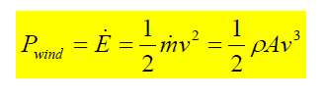
Wind power overview
Wind energy is conveyed by the uneven heating of the earth by the sun.
Local topography (mountains) can enhance or restrict the natural wind flow.
A 10 % change in speed will result in a 33% change in energy.
Turbulence Decreases the Effectiveness of a wind Turbine and imposes more wear and tear on the Wind Turbine.

Slide 4
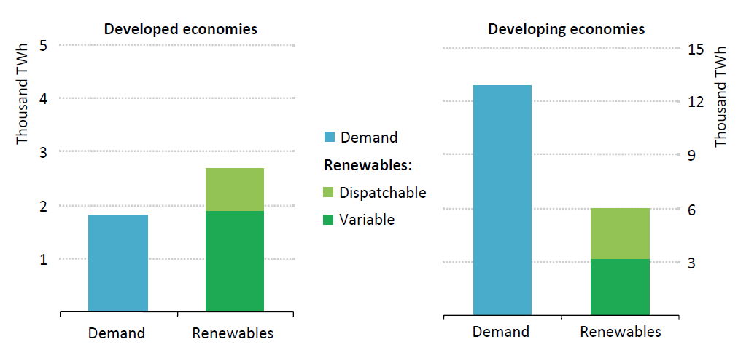
Wind power overview
Change in total electricity demand and renewable-based power supply in the New Policies Scenario 2014-2040
Source: IEA World Energy Outlook 2016.

Slide 5
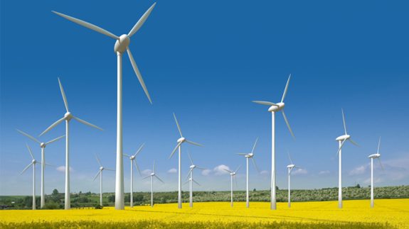
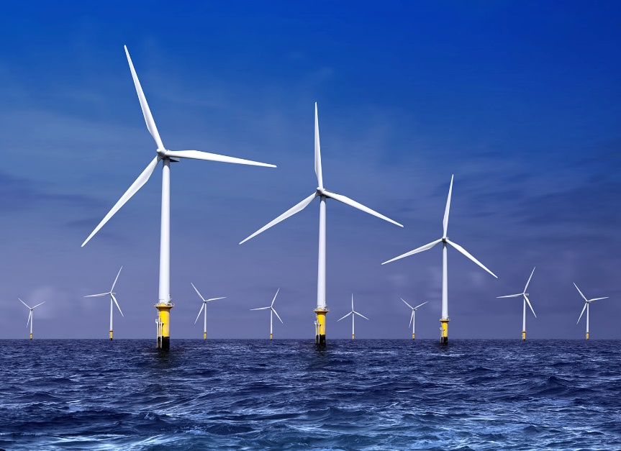
Wind power overview
Onshore
Offshore

Slide 6
Wind power overview
Output really depends on location characteristics.
Higher performance but also higher investment cost in offshore.
Intermittent output, not completely predictable.
Betz limit: up to 16/27 of the power in the wind can be converted to mechanical power by a turbine.

Slide 7
Wind power: economic concerns
Land use
A modern wind farm uses only 1% of the land occupied and the towers only 0.2%
Access roads must be build for
Land-based farms
The average wind farm requires 0.1 km2 of unobstructed land per megawatt of design capacity
High level of intermittency and unpredictability
Not a stand-alone source
To be coupled either with other generation technologies or storage

Slide 8
Wind power: environmental concerns
Electromagnetic effects and increased sediment temperature along cables for direct current.
Changed erosion and accumulation conditions.
Physical encroachments on habitats.
Barrier effects, e.g. at migration.
Fragmentation of landscape.
Visual appearance – light, shadows and reflexes – may be disturbing for both wild and domestic animals.

Slide 9
Wind power: social concerns
Aesthetics
Visual perception
Flickering
Electromagnetic interference - Now minimized/eliminated with fiberglass blades
Noise (mechanical and electrical equipment; aerodynamic)
200 meters away from a wind turbine a normal noise level at wind speeds about 8m/s is 45 dBA
Denmark: minimum distance to households 200m
Sweden: wind turbines are usually not placed closer than 300-500 meter from nearest household

Slide 10
Technologies in the wind chain
On-shore wind
Off-shore wind

Slide 11
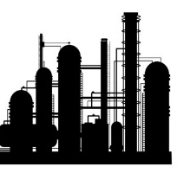
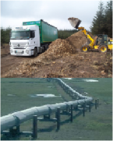
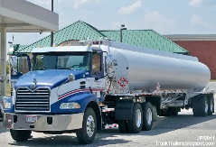

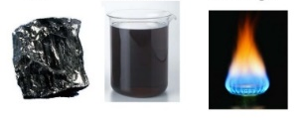
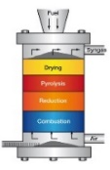

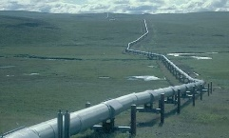


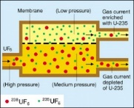

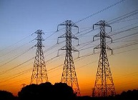


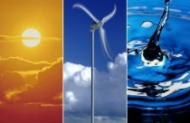
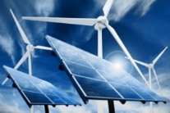
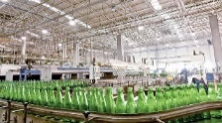
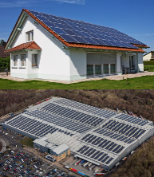
Sample Reference Energy System
Import / Extraction+processing of fossil fuels
Fuel transportation
Refinery
Transportation of oil products
Energy demand
Transportation sector
Oil
Oil
Gas
Oil products
Coal
Coal
Gasification
Combustion-based
power plant
Import / Production of biomass
Coal
Gas distribution
Energy demand
Residential sector
Biomass
Syngas
Electricity
Electricity transmission and distribution
Import / Extraction+processing of Uranium
Uranium
enrichment
Nuclear
power plant
Energy demand
Commercial sector
Centralised renewable
power plants
Energy demand
Industrial sector
Sun, wind, water
Decentralised energy supply
Sun
Water
Wind
Heat
Notes:
Let us see how the wind energy supply chain is placed in an ’energy system’ of e.g. a country.
Here we see a schematic (and simplified) representation of an energy system, which we call ’Reference Energy System’ (RES).

Slide 12
Sample Reference Energy System: Wind
Energy demand
Transportation sector
Energy demand
Residential sector
Electricity transmission and distribution
Energy demand
Commercial sector
Centralised renewable
power plants
Electricity
Energy demand
Industrial sector
Decentralised energy supply
Wind
Notes:
Let us see how the wind energy supply chain is placed in an ’energy system’ of e.g. a country.
Here we see a schematic (and simplified) representation of an energy system, which we call ’Reference Energy System’ (RES).
Now we will focus only on the part of the RES

Slide 13
Onshore wind
Key characteristics
Onshore wind
Capital cost onshore | 1400 €/kW
FOM cost | 2.7% of capital
Avg. capacity factor | 23%
Indirect GHG emission factor | 10 tCO2 eq/GWh
Lifetime | 20 years
Mature technology, lowest costs in the United States and China.
The overall performance of wind power depends on the specific characteristics of each location.
The capacity of a wind turbine can vary from a few kW to 9MW.
If the exact same (group of) wind turbine(s) is installed in different locations, the parameter that changes is the capacity factor.
Notes:
Note: no techno-economic-environmental data is available at the moment on IEA-ETSAP regarding wind. The data shown in this slide and more can be found on JRC’s Energy Technology Reference Indicators (ETRI), available on the web.

Slide 14
Offshore wind
Key characteristics
Offshore wind
Capital cost onshore | 3470 €/kW
FOM cost | 3.7% of capital
Avg. capacity factor | 34%
Indirect GHG emission factor | 16 tCO2 eq/GWh
Lifetime | 20 years
Mature technology in Northern Europe, but experience still limited elsewhere.
In general, higher costs than onshore, but also higher performance (especially in terms of capacity factors).
Higher capacity factors due among others to lower disturbance of the flow.
Notes:
To be noticed: the cost and the lifecycle emissions are higher than the onshore wind, but the capacity factor too.

Slide 15
References and reading material

Slide 16
IEA, World Energy Outlook 2016;
European Commission, Joint Research Centre, Energy Technology Reference Indicators (ETRI) 2014. Available at: https://setis.ec.europa.eu/sites/default/files/reports/ETRI-2014.pdf;
IEA, NEA, Projected Costs of Generating Electricity 2015. Available at: https://www.oecd-nea.org/ndd/pubs/2015/7057-proj-costs-electricity-2015.pdf;
IEA-ETSAP, Energy Technology Data Source. Available at: https://iea-etsap.org/index.php/energy-technology-data;

Slide 17
Sources for the RES pictures
Gasification: http://www.gbgasifired.com/model.html
Extraction: http://www.energytrendsinsider.com/research/coal/coal-mining-and-processing/
Refinery: http://stillwaterassociates.com/crack-spread-a-quick-and-dirty-indicator-of-refining-profitability/
Biomass: http://inhabitat.com/tag/biomass/
Renewables: http://www.topnews.in/wind-water-and-sun-beat-biofuels-nuclear-and-coal-clean-energy-297577
Uranium: http://unitednuclear.com/index.php?main_page=product_info&products_id=1028
Fossil: https://www.slideshare.net/MMoiraWhitehouse/fossil-fuels-teach
Combustion based power plants: https://en.wikipedia.org/wiki/Battersea_Power_Station_in_popular_culture
Uranium enrichment: http://energyfromthorium.com/2010/08/06/loveswu1/
Residential: http://jhsimpson.com/residential/
Transport: https://se.123rf.com/clipart-vektorer/transport.html
Industry: http://indianexpress.com/article/business/economy/factory-output-grows-2-per-cent-in-february-after-3-months-of-contraction/
Commercial: http://www.alfalaval.com/industries/refrigeration/commercial-refrigeration/
Transportation of fuel: http://www.zerohedge.com/news/2017-06-23/demand-oil-pipeline-capacity-hits-6-year-low
Transportation of biomass: http://www.forestenergy.ie/transportation-studies.php
Transportation of oil products: http://www.picquery.com/gasoline-truck_WXRZaplkZ2eaRVifu*zjqPAvrMnnxmBsTSgdn*BBBKk/

Slide 18
Sources for the RES pictures
Decentralized energy supply: http://trayamtechnologies.com/solar-pv-roof-top-and-ground-mounting/
Decentralized energy supply2: http://www.sunwindenergy.com/photovoltaics/38-mw-rooftop-pv-system-completed-uk
Biogas and bio-synthetic gas production: https://ehp.niehs.nih.gov/123-a180/
Onshore wind: https://www.mitchelltech.edu/programs/on-campus/energy-production-transmission/wind-turbine-technology
Offshore wind: http://inhabitat.com/tag/offshore-wind-farm/
Solar tower: http://www.power-technology.com/projects/seville-solar-tower/seville-solar-tower1.html
PV panels: https://dir.indiamart.com/coimbatore/solar-pv-panel.html
Solar power area requirements: http://forums.mwerks.com/showthread.php?7477561-Global-Energy-Thread
Bioenergy conversion: http://14.139.172.204/nptel/CSE/Web/103102022/environmental%20issues%20and%20new%20trends/ecological%20consideration%20in%20petroleum%20refinery.html

Slide 19
Changelog and attribution
Date | Author | Reviewer | Reviser
2017-09-26 | Georgios Avgerinopoulos | Mark Howells | Georgios Avgerinopoulos
To correctly reference this work, please use the following:
Avgerinopoulos, G., 2017. Wind power: Social, environmental and economic concerns, OpTIMUS.community. Available at: http://www.osemosys.org/understanding-the-energy-system.html. [Access date]

